Slide 1


Slide 2

LEARNING
Prepared by
Dr/ Sanaa Saber Mohamed
Critical Care Nursing Department

Slide 3
outlines
Introduction.
Definition of learning.
Process of learning.
Characteristics of learning.
Domains of learning.
Principles of learning.
Barriers to learning.

Slide 4

Definition of learning
It is process resulting in some modification relatively permanent of the behavior, way of thinking, feeling and doing of the learner.

Slide 5
is a mental activity by means of which knowledge, skills, attitudes and appreciations are acquired, resulting in the modifications of behavior.

Slide 6


Slide 7
Process of learning.
observation
Noting details, attending seeing what is going on the course of an experience, an event, or a situation.
Description
Recalling and verbalizing what went on, telling it to someone, writing it down, it is collection of the data of experience
Analysis
Identifying possible and significant meanings, comparing and noting similarities and dissimilarities.

Slide 8
Evaluation
Testing the learning product through usage
validation
Validation of the learning product, checking the meaning and the interferences derived by the learner with other, readings

Slide 9

Characteristics of learning

Slide 10

1- Learning is growth:
The word growth is generally associated with the body which is growing, but through the mental growth of the learner. For example; the child grows mentally and physically therefore the learning is growth through experience.

Slide 11
2- Learning is adjustment
Learning helps the individual to adjust himself or herself adequately to the new situations. Repeated efforts are acquired to react effectively and find solution to adjust the new situations.

Slide 12
3- Learning is organizing experience
Learning is not more addition of knowledge. It is not more acquisition of facts and skills through exercise and repetition. It is reorganization of experience.

Slide 13
4- Learning is purposeful
All true learning is based on purpose. For example all school activities should be purposeful so that child should feel real urge for learning.

Slide 14
5- Learning is intelligent
When the learner learns something unintelligently, he is likely to forget very soon and he doesn't assimilate but simply commits to memory. Only efforts made intelligently have lasting effects.

Slide 15
6- Learning is an active process
Learning does not take place without a purpose and self-activity. In that teaching-learning process, the activity of the learner count more than the activity of the teacher .the principles of learning by doing is main principle.

Slide 16
7-Learning is both individual and social
Learning is more than individual activity, it is social activity also. Individual mind is affected by the group mind consciously as well as unconsciously as individual is influences by his friends, relatives, and learns their ideas and feeling from parents

Slide 17
8-Learning depends upon insight
Lasting learning depends upon insight. insight has sometimes been described as the" flash of understanding".

Slide 18
9-Learning take place through trail and error
Some learning is the out come of trail and error.
10-Learning affects the conduct of the learner
There is a change in the mental structure of the learner after every experience.

Slide 19
11-Learning is the product of environment
Environment plays an important role in the growth and development of the individual. Environment should be healthy and rich in educative possibilities.

Slide 20
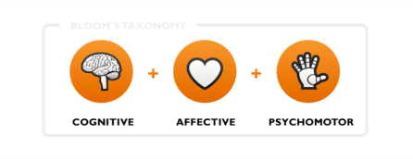
1-Cognitive domain
Is concerned with information and knowledge, facts and figures, concepts and principles. Application of principles, analysis, and synthesis, evaluation and decision-making belong to the cognitive domain.

Slide 21
2-The psychomotor domain
The psychomotor domain comprises of motor or muscular activities guided by human mind. Manipulative skills, neuromuscular coordination, operation of equipment of psychomotor domain.

Slide 22
3-The affective domain
Includes attitudes, values and concern for others e.g. maintenance of discipline, safety and readiness for work.

Slide 23
Principles of learning
Readiness
Individuals learn best when they are physically, mentally, and emotionally ready to learn, and they do not learn well if they see no reason for learning
Exercise
The principle of exercise states that those things most often repeated are best remembered. It is the basis of practice. It has been proven that students learn best and retain information longer when they have meaningful practice and repetition.

Slide 24
Effect
learning is strengthened when accompanied by a pleasant or satisfying feeling, and that learning is weakened when associated with an unpleasant feeling.* Positive reinforcement is more lead to success and motivate the learner and give them a feeling of satisfaction, Therefore, instructors should be caution about using punishment in the classroom.
Primacy.
The principle Primacy that, the state of being first, often creates a strong. The instructor must present subject matter in a logical order, step by step, making sure the students have already learned the preceding step.

Slide 25
Recency
The principle of recency states that things most recently learned are best remembered. Conversely, the further a student is removed time-wise from a new fact or understanding, the more difficult it is to remember.
Intensity
The principle of intensity implies that a student will learn more from the real thing than from a substitute.
For example, a student is likely to gain greater understanding of tasks by performing them rather than merely reading about them.

Slide 26
Freedom
The principle of freedom states that things freely learned are best learned. Conversely, the further a student is enforced, the more difficult is for him to learn, Since learning is an active process, students must have freedom: freedom of choice, freedom of action, freedom to bear the results of action -these are the three great freedoms that constitute personal responsibility.

Slide 27

Barriers to learning
1-Factors related to the teacher
a- Lack of motivation to teach
b- Lack of knowledge and experience
c- Relegated teaching to a low priority status.
d -unsuitable time to teach.

Slide 28
Barriers to learning
2-Factors related to the learner
a- Diminished learner motivation.
b- Lack of support and ongoing positive reinforcement
c- Denial of learning need, resentment of authority, and lack of willingness to tack responsibility.
d -Lack of time to learn impeding the ability and willingness to learn

Slide 29
Barriers to learning
3-Factors related to the environment
a- Too hot or too cold environment. .
b- Lack of control and lack of privacy.
c- Un available resources
d -Lack of space in settings where nurses are expected to teach, noise, frequent interferences, and treatment schedules.

Slide 30
Barriers to learning
4-Factors related to the Subject of the study
a- Lack of mass (physical object) of what is being studied.
b-Too steep a study gradient.
c-The third and most important barrier is the misunderstood word.

Slide 31
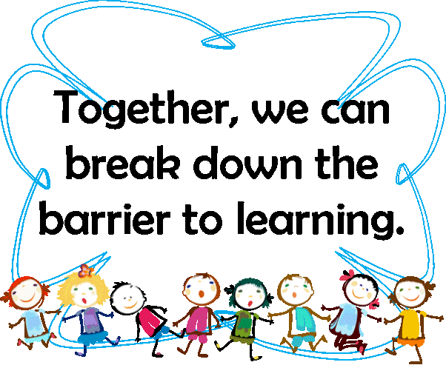

Slide 32


